Slide 1
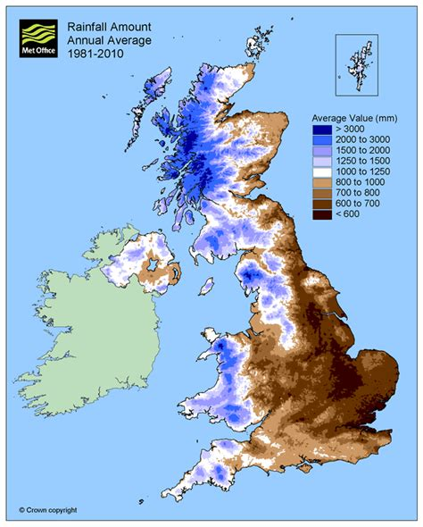
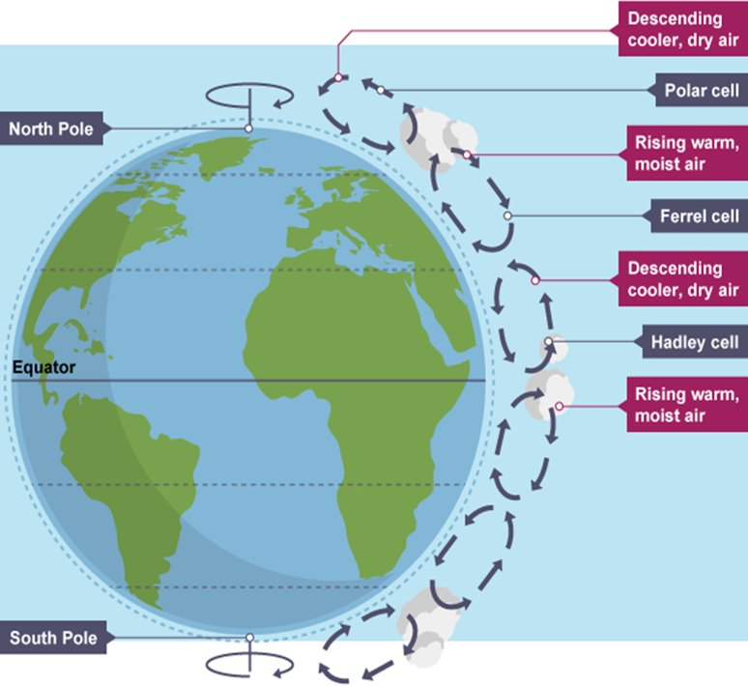
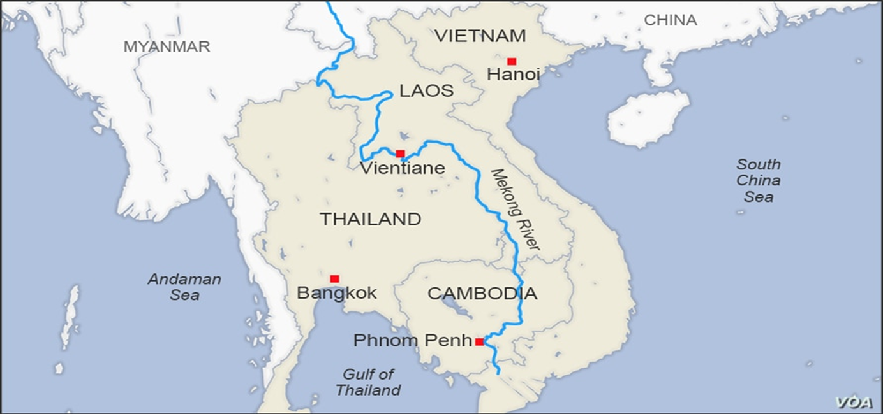
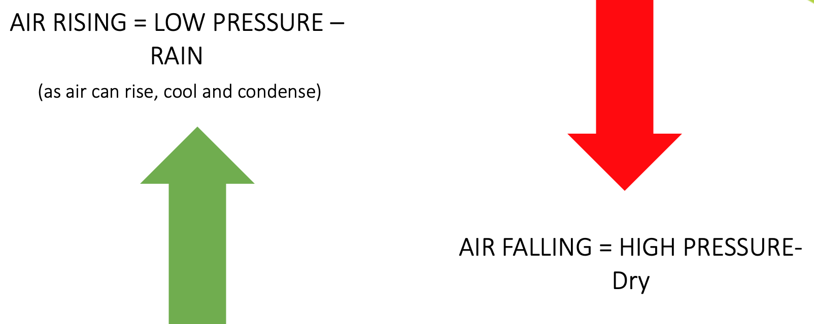
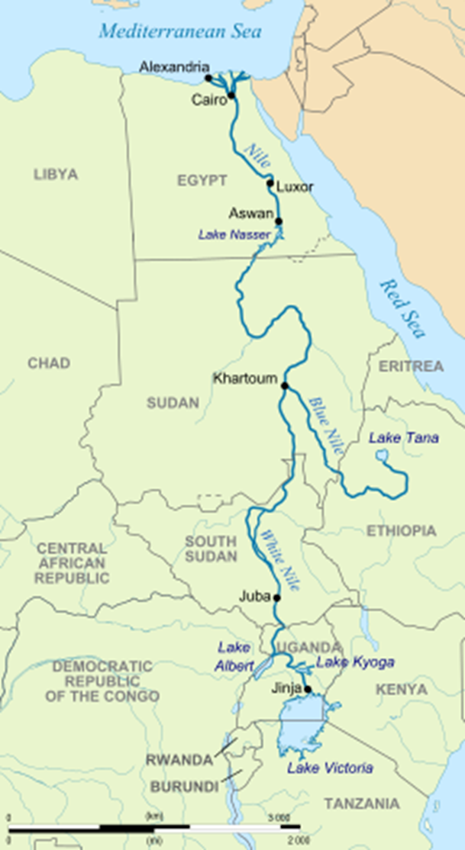
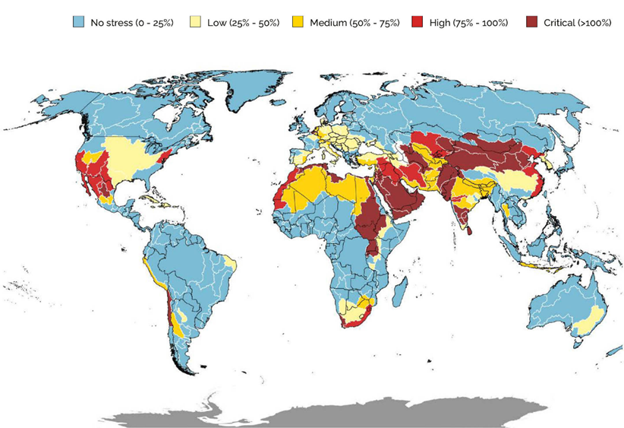
Water Resources Knowledge Organiser
Rising Population – Everyone needs water in order to survive. People also use water for hygiene, cooking and cleaning. The population of the world is increasing therefore more water is needed. | Economic development- As countries develop, their water use increases. People in wealthier nations have water delivered into their homes via pipeline. Modern appliances, such as dishwashers and washing machines, use a lot of water | Climate Change – Rising temperatures will cause more and more water sources to dry up.
Lack of global freshwater- Freshwater makes up approximately 1% of the water on Earth, meaning freshwater is already limited. | Physical Environment – The location of rivers in relation to populations. Population centres which are not located close to water sources are at a higher risk of experiencing water insecurity, due to not being able to easily access the water supply. | Agriculture - Agriculture uses 70% of the world’s accessible freshwater, but some 60% of this is wasted due to leaky irrigation systems, inefficient methods as well as the growing of crops that are too thirsty for the environment in which they are grown
What factors affect the Rainfall
Global atmospheric circulation model-
Air rises at the equator = low pressure = rainfall. When the air reaches the edge of the atmosphere, it cannot go any further and so it travels to the north and south. The air becomes colder and denser, and falls = high pressure and dry conditions at around 30° north and south of the equator.
Kielder Water: Water Transfer Schemes
Kielder Water is a large reservoir in Northumberland, built as part of a water transfer scheme to supply water to the northeast of England. One major positive is that it helps balance water availability across regions, transferring water from areas with surplus (like Northumberland) to areas with higher demand (like Teesside). This supports industry, agriculture, and domestic use, especially during dry periods. The reservoir also provides recreational opportunities and supports wildlife habitats. However, there are negatives too. The scheme was expensive to build and maintain, and some argue it was over-engineered, as demand did not grow as expected. Environmental concerns include disruption to local ecosystems and the flooding of farmland during construction. Additionally, transferring water over long distances can be energy-intensive and may contribute to carbon emissions. Overall, while Kielder Water offers strategic benefits, it also raises questions about environmental impact and long-term sustainability.
In the UK there is water stress in the south- east of England due to increased population and lack of rainfall
Transboundary River Mekong -
A river the goes through more than one country.
Transboundary River Nile -
A river the goes through more than one country.
The Nile River is a transboundary river flowing through 11 countries in Africa, including Egypt, Sudan, and Ethiopia. Water transfer and dam projects, like the Grand Ethiopian Renaissance Dam (GERD), aim to improve water supply, generate hydroelectric power, and support agriculture. These developments can boost economies and reduce reliance on fossil fuels. However, there are major concerns. Countries downstream, especially Egypt, fear reduced water flow, which could harm farming and water access. This has led to political tensions and disputes over water rights.
The Mekong River flows through six countries in Southeast Asia, making it a key transboundary water source. Water transfer and dam projects bring benefits like hydroelectric power, flood control, and improved irrigation, helping economic development. However, there are serious downsides. Dams built upstream can reduce water flow downstream, harming fish stocks and farming communities, especially in Cambodia and Vietnam. This affects food security and local livelihoods. Disagreements between countries over water use also create political tensions. While the Mekong’s water schemes offer development opportunities, they must be carefully managed to avoid environmental damage and conflict.
Water scarcity: Not having enough water for all the people living in a country to cover their basic needs.
Water Stress: When there is a shortage of water which creates risks for individuals, farmers or industries.
Water security: When a society has enough water to ensure that everyone has clean water, sanitation (toilets), good health and the economy has enough water to grow food and make products.
Water transfers: Where water is moved from an area of surplus to an area of deficit.
Natural rivers are used in conjunction with canals and underground pipes to move water from the North and West to the South and East.

