Slide 1
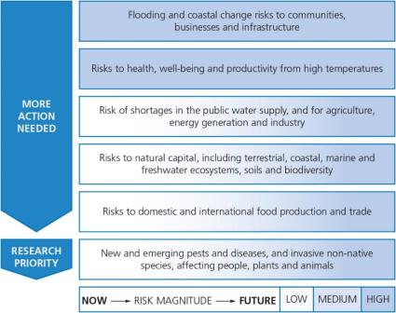
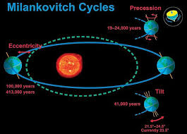


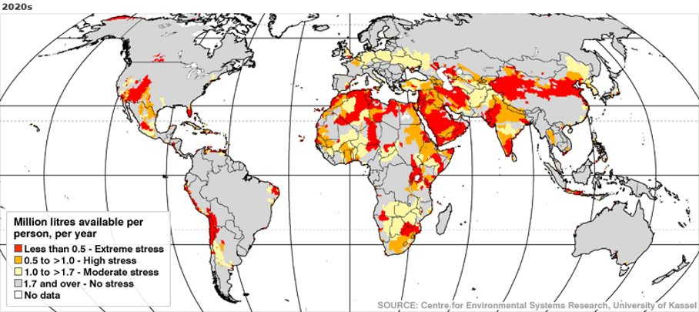
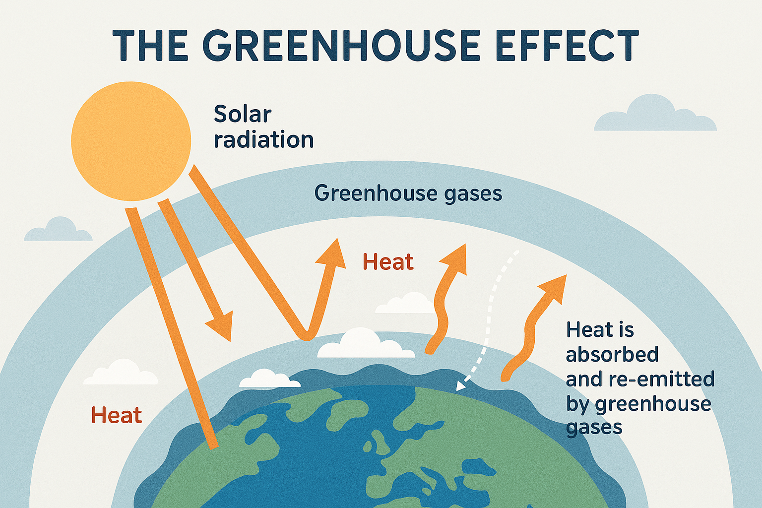
Climate Change
What are the physical causes of climate change?
Volcanic eruptions (release of CO₂ and aerosols)
Solar radiation variations (changes in sunspot activity)
Orbital changes (Milankovitch cycles
Human causes of climate Change –
Burning fossil fuels (CO₂ emissions)
Deforestation (loss of carbon sinks)
Industrial processes (greenhouse gases)
Agriculture (methane from livestock)
Transportation (vehicle emissions)
Evidence of climate change includes:
Rising global temperatures (average increase of ~1.1°C since pre-industrial times)
Melting glaciers and ice sheets (Greenland, Antarctica)
Sea level rise (about 20 cm since 1900)
More extreme weather events (heatwaves, hurricanes)
Ocean acidification (due to CO₂ absorption)Shifts in ecosystems (species migration, coral bleaching)
Tree rings and ice cores.
Quaternary Period
The quaternary period is the current geological time period that we live in.
We live in the Holocene Epoch.
The temperature has fluctuated in the last 2.6 million years in the quaternary period.
When it warm, we have interglacial periods.
When it cold we have glacial periods (ice age)
How can we respond to climate change?
Maldives Consequences of Rising Sea Level
TEST YOURSELF
:
‘Destruction of ecosystems is necessary if global interdependence is to continue. How far do you agree with this statement? (6 marks)
Give two ways ‘agribusiness negatively impacts the environment (4 marks)
Explain why the disposal of waste impacts the environment (4 marks)
Describe the long-term impacts of climate change on the UK (4 marks)
How might people's lifestyles change in the future in a warmer world (4 marks)
Explain how ecotourism can be an effective strategy in the sustainable management of tropical ‘The effects of climate change are greater on the environment than on people.’ Do you agree with this statement? Justify your decision. (8 marks)
Explain the human causes of climate change (4 marks)
Explain the physical causes of climate change (4 marks)
Human impact of climate change impact our planet more. How far do you agree with the statement? (8 marks)
Mitigation - reduce or prevent greenhouse gases.
Carbon Capture -
- capturing CO₂ released by industry or through burning fossil fuels and storing it safely underground.
Afforestation –
- 73 million trees in the Brazilian Amazon by 2023.
International Agreements –
- Paris Climate Agreement with the aim to keep increase in temperatures below 2ºc.
The Maldives faces severe impacts from rising sea levels, threatening to submerge low-lying islands. Coastal erosion damages infrastructure and reduces habitable land. Saltwater intrusion contaminates freshwater supplies, harming agriculture. Coral reefs suffer bleaching due to warmer oceans, reducing fish stocks and tourism income. Increased flooding and storm surges displace communities, creating climate refugees. Economic dependence on tourism and fishing makes the nation highly vulnerable, risking livelihoods and long-term sustainability.
Climate Change in UK:
A warmer atmosphere will mean the air masses over the oceans will have greater moisture content.
Adaptation - Responds to the impact of climate change and tries to make populations less vulnerable.
Change in agriculture-
-Move location of farming
-Drought efficient crops
Manage water supply –
-Increase supply
- Water efficient devices
Reduce risk of sea level –
- Thames Barrier to stop water entering
- Build homes on stilts
Short term impacts:
Food price increase
Increase in flash flooding
More extreme weather events (eg: 2003 heatwave)
Long term impacts:
Economic cost of flooding could rise from £1 billion to £27 billion in 2080
Severe water shortages by 2050 2.5x greater demand than
Supply.
2 metre sea level rise on UK coasts by 2080.
Climate change
The long-term alteration of Earth’s climate patterns, primarily due to natural processes and human activities. It involves shifts in temperature, precipitation, and extreme weather events, largely driven by increased greenhouse gas emissions and global warming
Green House Effect:
The greenhouse effect is the process where greenhouse gases in Earth’s atmosphere trap heat from the sun, preventing it from escaping back into space. This natural phenomenon keeps Earth warm, but excess gases cause global warming.
Sustainable Tourism –
Ethical Tourism = Needs of the locals are considered.
Responsible Travel = Local families benefit economically
Ecotourism = Tourism that has a very low environmental impact
Global Change in Water Supply–
Glacier and snow melt reducing long-term freshwater availability.
Droughts becoming more frequent, lowering river and reservoir levels.
Altered rainfall patterns causing water scarcity in some regions and flooding in others.
Saltwater intrusion into coastal aquifers due to rising sea levels.
Decreased groundwater recharge from prolonged dry periods
.Water quality degradation from higher temperatures and pollution
Biological
Economic improvement
Impact on culture
Increased environmental awareness:
Threats to culture
Relocation of locals
Ecosystem degradation
Jobs provided to locals
Global Warming
Global warming is the long-term increase in Earth’s average surface temperature

