Slide 1
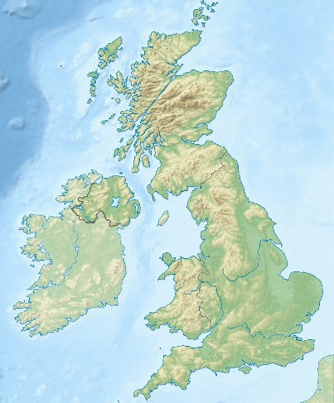
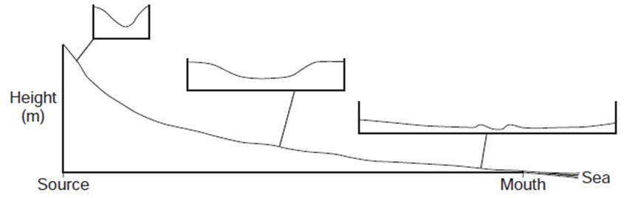
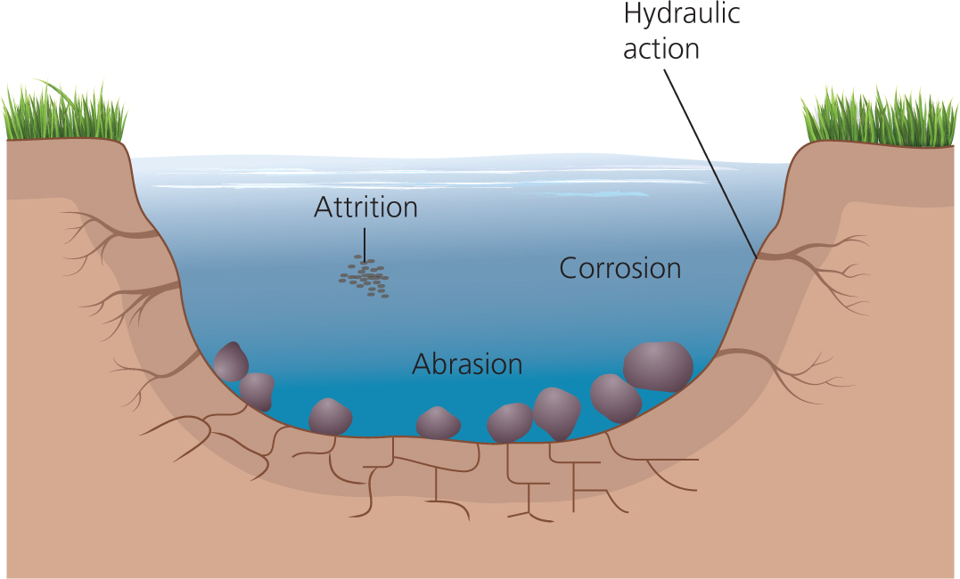
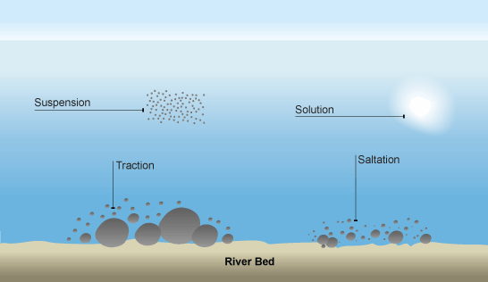


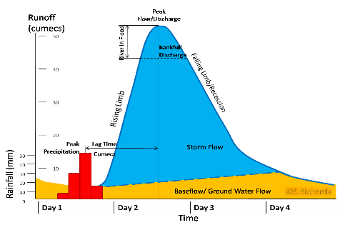









Relief of the UK
The relief (height of the land) of the UK can be divided into uplands and lowlands; each have their own characteristics.
Key
Lowlands
Uplands
Highland (upland) areas, often over 600 metres above sea level; e.g. the Scottish Highlands (glaciated mountains).
Processes
Transportation - The movement of sediment along the coast | Erosion - The breakdown of sediment into smaller fragments | Deposition - When waves loose energy they leave behind the smaller pieces.
Traction - large material is rolled along the sea floor. | Hydraulic Action – The force of water into cracks helps to break it up.
Saltation - beach material is bounced along the sea floor. | Abrasion – Waves fling sand and pebbles against the rock. These wear away like sandpaper.
Suspension - beach material is suspended and carried by the waves. | Attrition - Chunks of rock get knocked together and worn into smaller bits
Solution - material is dissolved and carried by the water. | Solution – Water dissolves the soluble material from the rock.
How a river’s cross profile changes downstream.
The long profile of a river shows the change in height of the river’s bed from its source to its mouth. It is typically concave, decreasing in gradient downstream. The cross profile shows the shape of the river valley.
Managing Distinctive Landscapes:
Establish fixed point photography of key viewpoints and animals
Improve signage by renewing or replacing finger posts to encourage people to stick to the routes.
Designated footpaths and Monitoring of footpath erosion
Work with local planning and housing authorities to promote affordable housing schemes using local rock
Strict control over visitors
Middle course
Upper course
Lower course
Lowland areas, under 200 metres above sea level, largely flat or low hills; e.g. the Fens in eastern England.
Upper Course of a River
Near the source, the river flows over a steep gradient but has limited energy. The river erodes vertically, producing V-shaped valleys, interlocking spurs, and waterfalls. Waterfall formation: River flows over layers of more resistant and less resistant rock Hydraulic action and abrasion causes a plunge pool in the less resistant rock The more resistant rock is undercut, leaving the rock unsupported The overhanging rock collapses and the waterfall retreats upstream, forming a gorge.
The landscape will be affected by four main factors; geology/ vegetation/ land use and culture.
Many of these areas in the UK can be considered an Area of Outstanding Natural Beauty such as the Lake District and Dartmoor.
Flood management schemes
Soft Engineering (enhancing natural processes) | Hard Engineering (building control structures)
Afforestation – plant trees in the upper course to increase interception to lengthen lag time, and increase evapotranspiration to reduce discharge. River restoration and managed flooding – restoring a river and wetlands to their natural state allows a river to flood there to decrease discharge downstream. Floodplain zoning – allow land uses such as parks in areas that are regularly flooded and restrict housing to areas that are infrequently flooded. | Artificial Levees – increase the height of the river banks to increase channel capacity. Deepening/widening the river channel – increase the channel capacity. Dam - reduces discharge by storing water in a reservoir. Flood diversion/relief channel – reduces discharge by diverting a proportion of discharge away from a city via a flow control structure on the river e.g. the Jubilee River (Thames).
Hydrographs
Hydrographs show how the discharge of a river (the volume of water that is flowing in it, measured in cumecs – cubic metres per second) changes over time. A ‘flashy’ hydrograph has a short lag time and a high peak discharge, caused by lots of surface runoff.
Peak discharge is the highest discharge.
Lag time is the delay between peak rainfall and peak discharge.
Rising limb is the increase in discharge.
Falling limb is the decrease in discharge
Baseflow is the discharge of the river fed by groundwater flow.
Rock Type
IGNEOUS: This is formed from molten rock often linked to volcanoes. The molten rock may cool slowly, allowing time for minerals to form large crystals, which lock together. Granite and basalt are types of igneous rock. Igneous rocks are very hard and durable. In the UK they form mountainous areas.
SEDIMENTARY: Most of these types of rocks are formed under the sea. On the sea bed they were buried by newer sediment, squeezed and cemented together over thousands of years to form new rock. These rocks also include the fossilised remains of sea creatures. Chalk and limestone are examples of sedimentary rocks.
METAMORPHIC: Existing rocks that are transformed by great heat or pressure. These changes lead to the existing minerals melting and forming new minerals. Marble and slate are examples of metamorphic rocks.
Middle Course of a River
The river now flows over a more gentle gradient, but has more energy (more water flowing, more quickly). The river erodes laterally, creating a u-shaped valley, meanders, and ox bow lakes. Formation of a meander and ox-bow lake:
Physical and Human Causes of Flooding.
Physical: Prolonged/heavy rainfall This causes the soil to become saturated, stopping infiltration and causing surface runoff which increase peak discharge. | Physical: Geology Impermeable rocks prevent infiltration, causing surface runoff which decrease lag time.
Human: Deforestation Clearing trees reduces interception and evapotranspiration, increasing peak discharge. | Human: Urbanisation Tarmac and concrete are impermeable, preventing infiltration and causing surface runoff.
LANDSCAPE AND PHYSICAL PROCESSES
Paper 1
1. The fastest flowing water erodes the outer bank forming a river cliff; slower water causes deposition on the inner bank, forming a slip off slope. | 2. Further erosion causes the two outside bends to move towards each other, narrowing the neck of the meander.
3.Erosion eventually cuts through the neck of the meander, and the fastest flow is redirected. | 4. Deposition separates the old meander loop from the new main channel, forming an ox-bow lake.
Drainage Basin
Drainage Basin | The area of land that is drained by the river and its tributaries.
Watershed | The area of high land forming the edge of the river basin
Precipitation | Moisture falling from clouds as rain, snow or hail.
Interception | Vegetation prevents water from reaching the ground.
Infiltration | Water absorbed into the soil .
Surface runoff | Water flowing quickly over the surface of the land into rivers.
Throughflow | Water flowing more slowly through the soil to the river.
Groundwater flow | Water flowing very slowly through rocks deep underground.
Transpiration | Water lost through the leaves of plants.
2007 River Severn Floods
Causes of the flood: There was two months of rain over a 24 hour period. The ground was already saturated with water. Two rivers meet near Tewksbury, the River Severn and the River Avon, increasing the flood potential. | Effects: School, homes, businesses, roads, farmland flooded. No water for thousands of people. Sewerage flooded farm fields. No electricity. Prison evacuated. Injury and risk to life.
Responses: Flood warnings. Military support emergency service at rescuing stranded people. Large news coverage. Search a rescue helicopters to air lift people who were trapped. Providing fresh bottled water after water station was flooded. To build new flood defences.
Lower Course of a River
Near the river’s mouth, the river flows over a very gentle gradient. The river is transporting a large load of sediment which it deposits. There is a wide floodplain with levees, and ox-bow lakes. An estuary with mudflats is formed where the river meets the sea (e.g. at Middlesbrough on the River Tees).

Slide 2
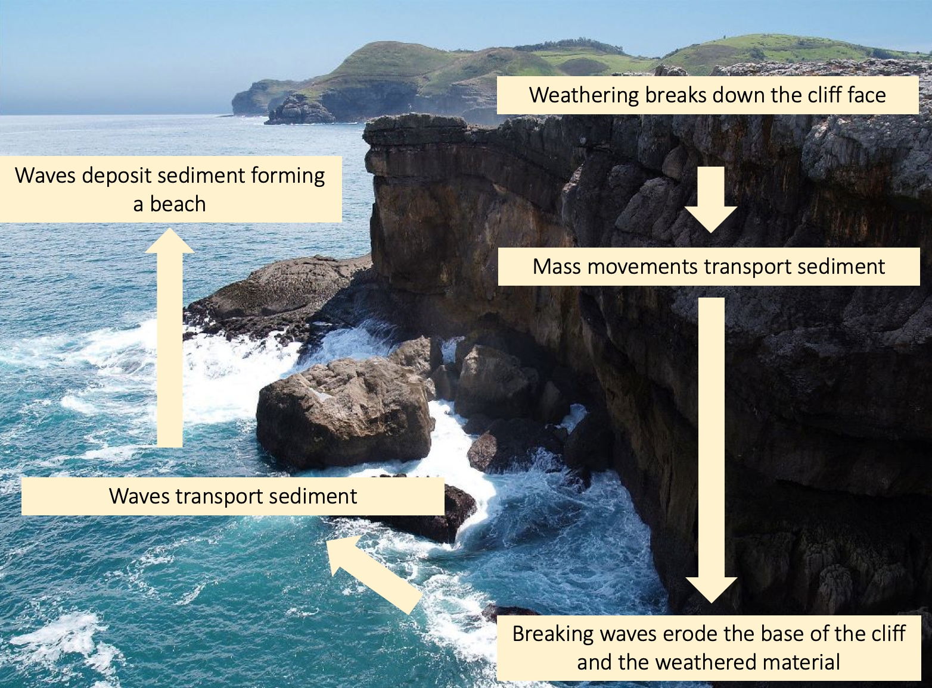
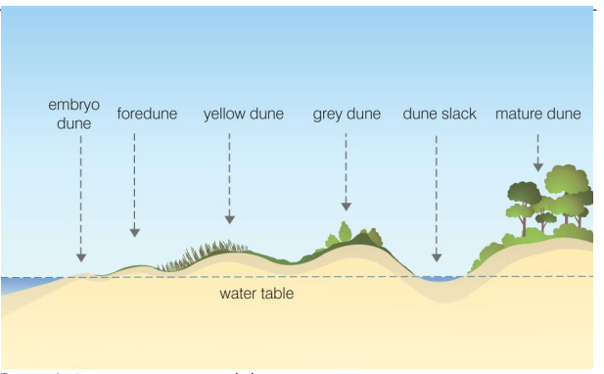
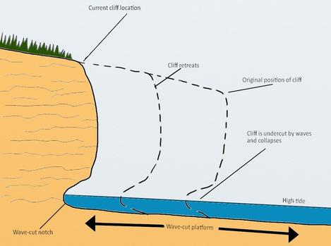
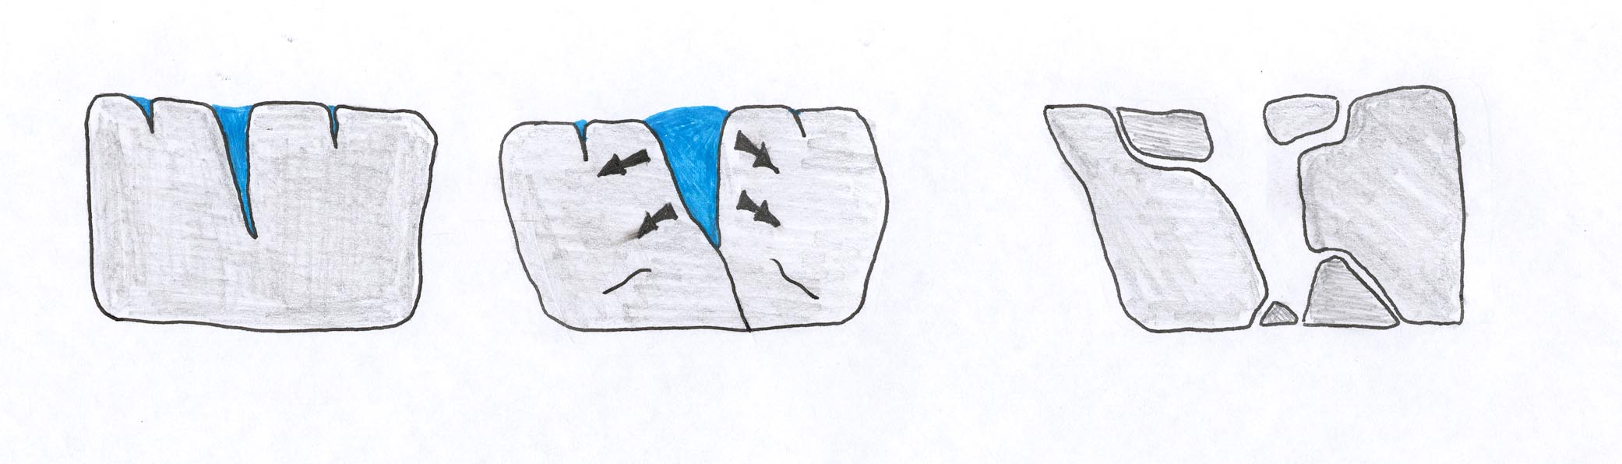
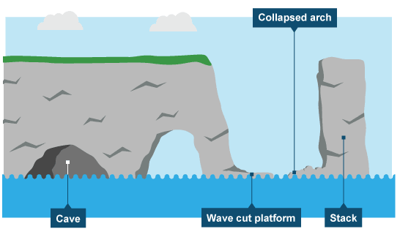
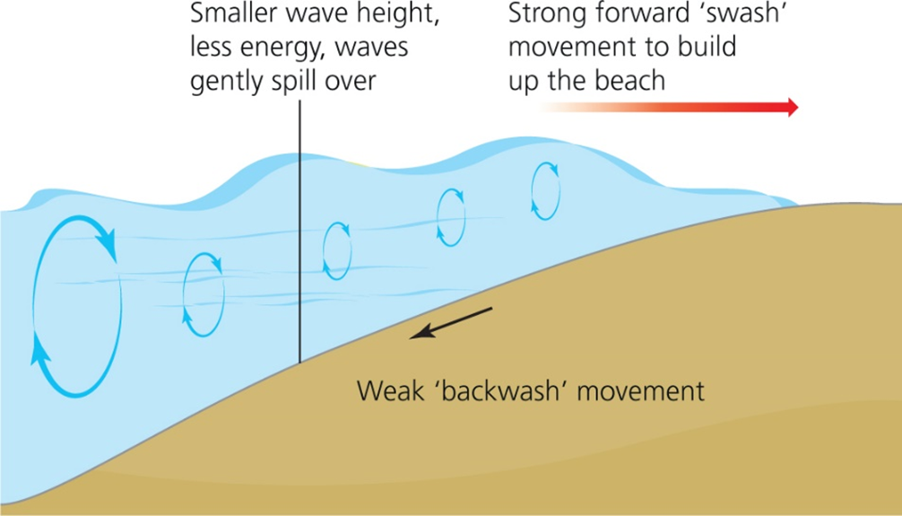
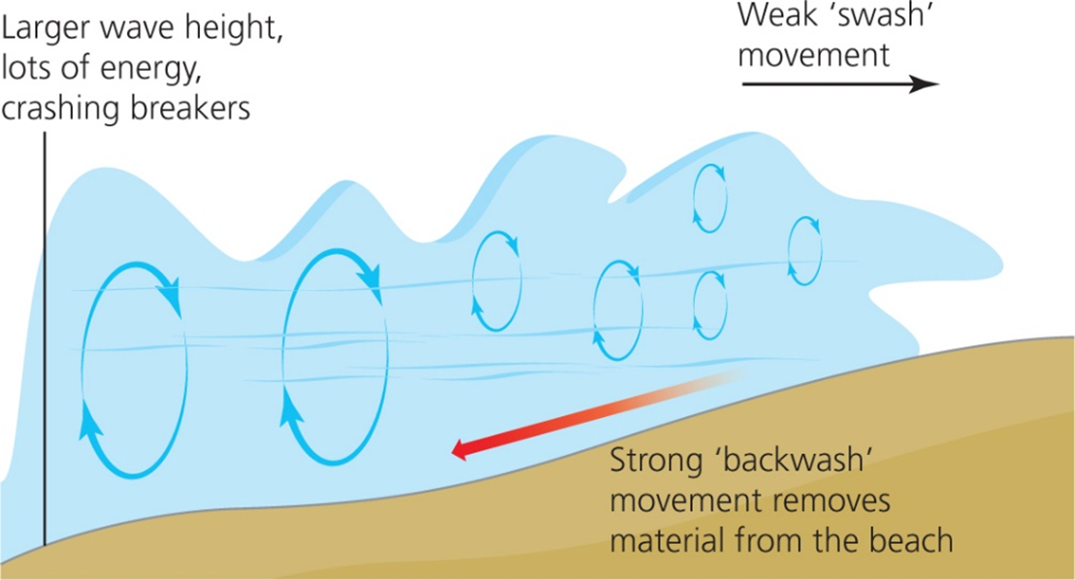
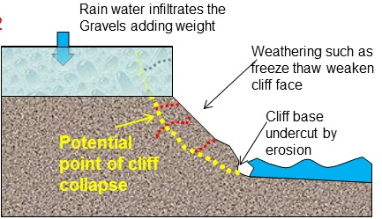
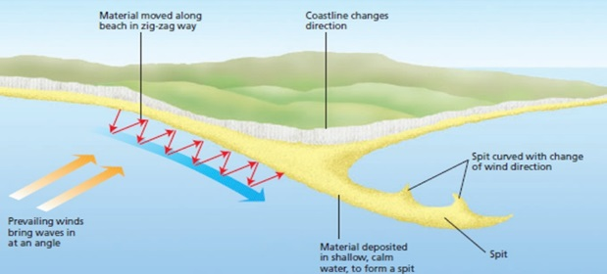
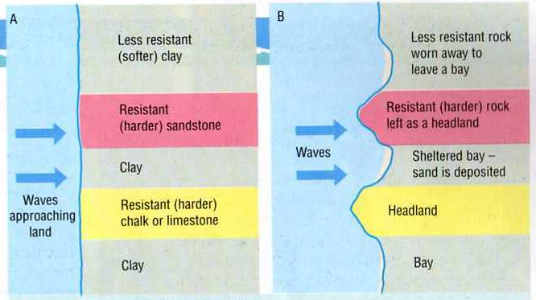

Weathering
Weathering is when rocks are broken down. There are 3 types of weathering;
Mechanical (physical) – When rocks break up due to water entering the cracks and freezing and thawing, making the rock weak.
Rainwater seeps into joints and fractures in the rock
When the water freezes its volume expands by 9% exerting pressure on the surrounding rock
With repeated freeze-thaw and angular block of the rock breaks away (scree)
Chemical – Caused by chemical changes. Slightly acidic rainwater slowly dissolves certain rock types
Biological – Plant roots grow causing cracks in the rocks and animals burrow into weak rocks like sand.
Mass Movement
Wave cut platform - Erosional Landform
Waves through hydraulic action cause erosion at the foot of the cliff. This erosion of a cliff at the base forms a wave cut notch. As the notch grows the rock above it becomes unstable and eventually collapses. The collapsed material is washed away and a new notch starts to form. Repeated collapsing causes the cliff to retreat. A wave cut platform is left behind as the cliff retreat
Sand dunes – Depositional Landform
Sand dunes are mounds of sand that are found behind sandy beaches. To form they require a large flat beach, a good supply of sand, strong wind and obstacles. Eg: Ynyslas sand dunes are located on the west coast of Wales. Erosion of the cliffs in Aberystwyth, longshore drift then transports material along the coast. Onshore Wind then deposits the sand into sand dunes.
Longshore drift
A form of transportation that moves sediment from one end of the coast to the other.
Waves approach the beach in the direction of the prevailing wind.
When waves break, swash pushes sediment diagonally up the beach.
Gravity pulls the water and sediment straight down the beach as backwash.
Over time, sediment is moved along the coast.
Waves
A wave is a movement of energy through water, not a movement of water. The size of the waves depend on 3 factors;
The FETCH (the distance the wind blows over the water) – The greater the fetch, the more powerful the waves will be.
The STRENGTH of the wind
How LONG the wind blows for
Mass movement happens when the force of gravity acting on a slope is greater than the force supporting it. This process causes the cliff to retreat (move back). There are 4 types of mass movement;
Rockfall – fragments of rock breaking away from the cliff face
Landslide – blocks of rock sliding downhill
Mudflow – saturated soil and weak rock flows down a slope
Slumping– slump of saturated soil and weak rock along a curved surface this forms by:
Rain saturates the permeable rock above the Impermeable rock, increasing its weight.
Waves or a river erode the base of the slope making it unstable.
Eventually the weight of the permeable rock is greater than the strength of the underlying rock and the slope collapses along a curved plane; on the coast the cliff retreats inland.
The loose material at the base of the slope is then removed and transported by waves or a river.
Formation of caves, arches, stacks and stumps by erosion
Hydraulic action and abrasion erodes the joints and other lines of weakness (cracks) in the cliff face These are enlarged to form a sea cave Wave refraction focuses energy on both sides of the headland; caves from both sides of the headland join together to form an arch Weathering (e.g. freeze-thaw) and erosion (e.g. abrasion) causes the arch to collapse forming a stack Further weathering and erosion forms a stump Eventually the stump is eroded, leaving a wave-cut platform Joint > Cave > Arch > Stack > Stump
TEST YOURSELF:
For a distinctive landscape you have studied, discuss whether the impacts of human activity are largely positive or negative (8)
Explain why footpaths are eroded at honeypot sites (4)
Explain the formation of a waterfall (6)
Explain why rivers deposit sediment on the inside bend of a meander (4)
Give two factors that influence which method of transportation a rivers bed load is moved by (2)
For a located coastal environment in the UK, explain the processes that have created the landforms specific to that environment (6)
Explain how climate influences the rate of erosion in river landscapes (4)
Explain how reduced infiltration in an area may result in flooding (4)
Explain how the process of longshore drift effects the coastal landscape (6)
Explain the impact on the rest of the drainage basin system of cutting down a large areas of trees (6)
Evaluate the costs and benefits of a dam as a flood management strategy (8)
List three factors which may affect flooding in the UK (3)
Describe how porous rocks will influence the shape of a hydrograph (4)
Evaluate the effectiveness of soft engineering as a strategy for managing UK floodplains in the future (8)
Give one reason why some people do not want money spent on river flood management. [2]
River Flooding is a natural phenomenon. ”To what extent do you consider this statement to be correct (8)
Explain how a change in the hydrological cycle in an area may result in flooding (6)
The Old Harry Rocks are located off Ballard Point, Dorset.
Constructive Waves | Destructive Waves
Swell formed from distant storms. Low wave height in proportion to wavelength. The swash is stronger than the backwash. Sediment is deposited, building-up the beach, forming a steep beach profile and berms. | Formed by local storms. High wave height in proportion to wavelength. The backwash is stronger than the swash. Sediment is eroded from the beach, forming a less steep beach profile and an offshore bar.
What factors effect landform change?
Geology, Climate and human use are methods that will effect the rate of change in both coastal and river landforms.
Formation of Spits by longshore drift and deposition
Swash moves sand up the beach at the angle of the prevailing wind Backwash moves sand down the beach at 90° to the coastline, due to gravity This zig-zag movement of sand is called longshore drift and it transports sand along the beach When the coastline changes direction, longshore drift deposits sand in the sea This deposition causes the beach to extend out from the coastline, forming a spit A change in the prevailing wind direction or ocean currents can form a hooked (or recurved) spit In the sheltered area behind the spit, waves and rivers deposit silt and sand forming mudflats and a saltmarsh
Headland and Bay- Erosional Landform
Waves erode the coastline. The softer (less-resistant) rock is eroded more quickly, forming a bay; e.g. the clay of Swanage Bay. Deposition in the sheltered bay forms a beach. The more resistant rock is eroded more slowly and is left jutting out in to the sea forming a headland; e.g. the chalk of Ballard Point.
 |  | Coasts | River
Geology | The type of rock that is being eroded and the way in which the rock types are laid down will affect the rate of change. | Concordant coastline: where layers of the rock run parallel to the coastline. So ratees of erosion are even along the coastline. EG: Llyn Peninsula Discordant coastline: Where bands of rock run at a 90º angle to the coast. This means erosion rates very. EG: Abersoch Bay | EG: The Bishopston river is formed of limestone which is easily eroded. As a result large caverns and sink holes allow the river to run underground. The river channel on the the surface is dry for the majority of the time and the majority of erosions occur underground.
Climate | Will effect the rate of change. This includes extreme weather events. | The prevailing wind affects the angle at which the waves break along the coastline and therefore the direction of erosion and transportation. The waves break on the beach at this angle, pushing material up and across the beach. Therefore it effects where depositional landforms form. | The more water flowing into the river the higher the erosion rates will be. The highest erosion rates in the UK are found in during the winter when there is the most rainfall.
Human use | Intended human activity includes management strategies to reduce the impact of erosion. | Management of beaches where the coastline is left exposed to erosion as the process of longshore drift. EG: Groynes at Criccieth beach absorb wave energy as well as prevent longshore drift. | The River Thames is protected as it runs through urbanised areas. To prevent erosion on the outside banks of meanders, gabions are put in place to absorb the power of the water.
Command Words:
Analyse - Take apart an idea, concept or statement and
criticise it.
Assess - Come to a conclusion about the overall value or significance of something; discuss its positive and negative aspects to show balance.
Compare - Identify similarities and differences.
Define - State the meaning of an idea or concept.
Describe - Set out the main characteristics of something; DON’T EXPLAIN.
Discuss -Set out both sides of an argument (for and against) and come to a conclusion; there should be some evidence of balance.
Evaluate - Make a judgement about the effectiveness of something; discuss its strengths and weaknesses and come to a conclusion about its overall success or importance.
Explain - Give reasons why something happens.
Give - Produce an answer from recall.
Justify - Support an idea or argument with evidence; for the outcome chosen, the positives must outweigh the negatives.
State = name
To what extent - Discuss and conclude how far you agree or disagree with a statement or view.
1
2
3
4
7
5
6
Beach – Deposition
A beach is a build up of sand and shingle and pebbles deposited by waves.
The swash needs to be stronger
Than the backwash.
Box = command word
Underline = key words
Glance = back
e.g. Spurn Head, Yorkshire

