Slide 1
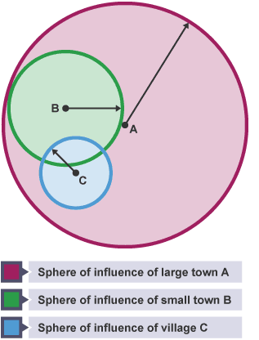
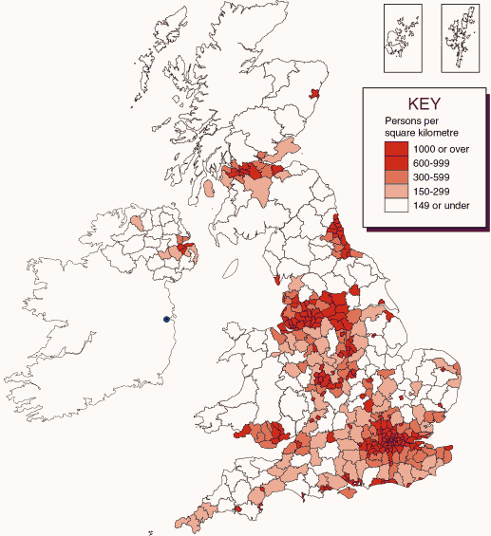

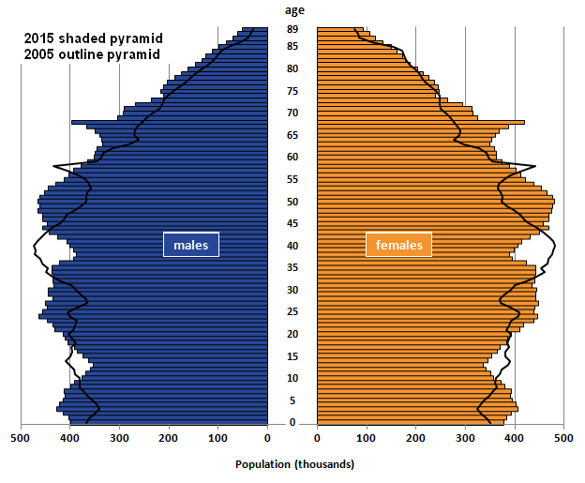

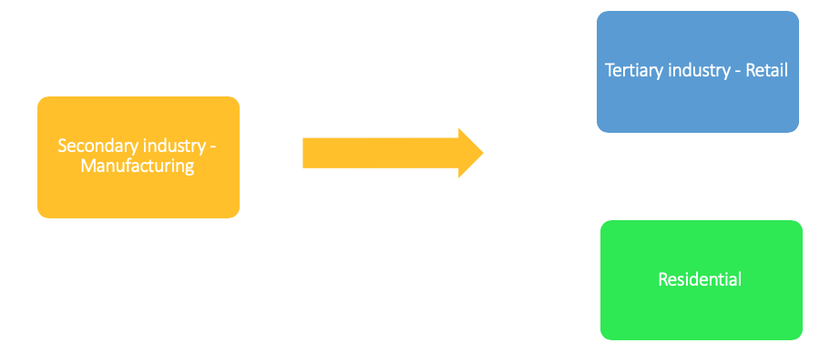


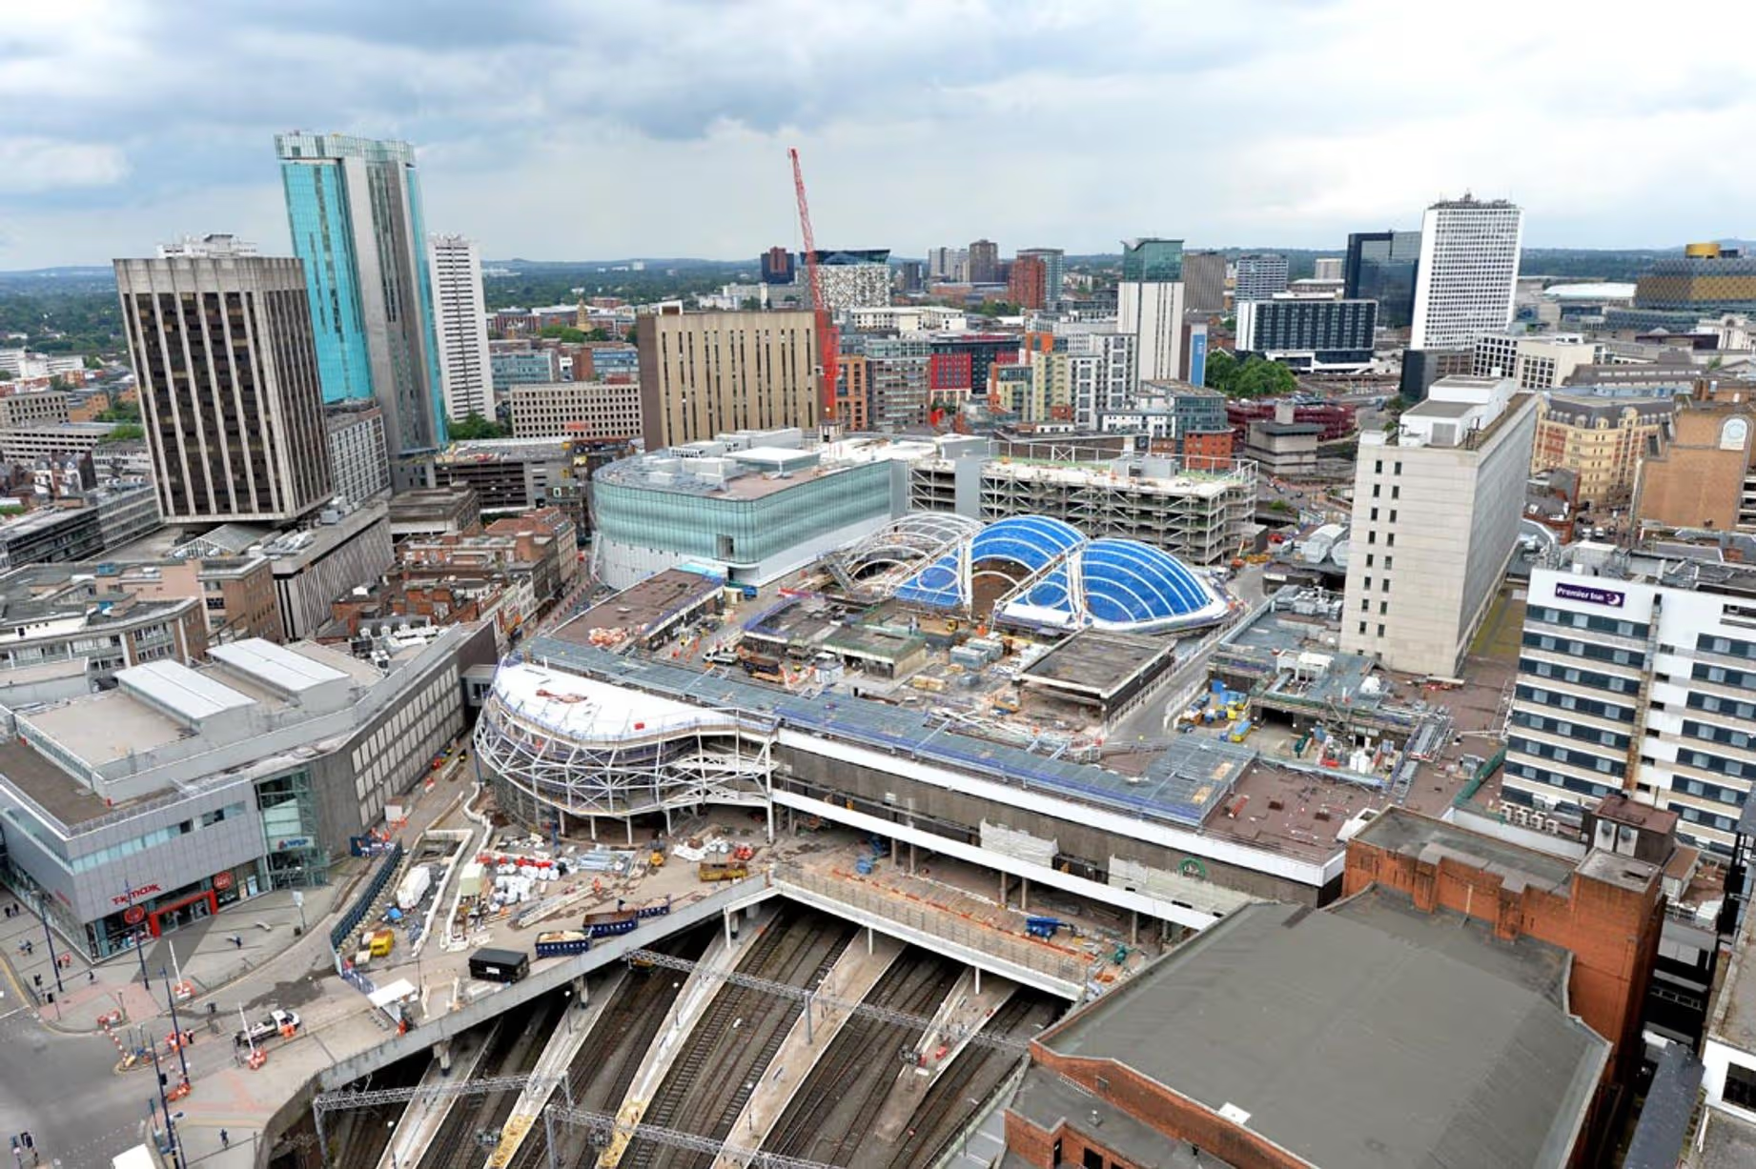
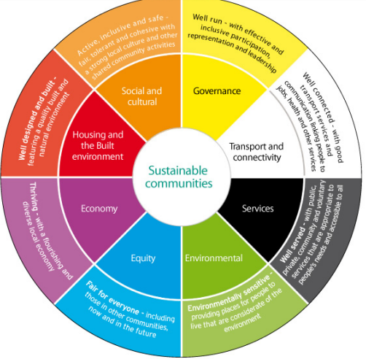
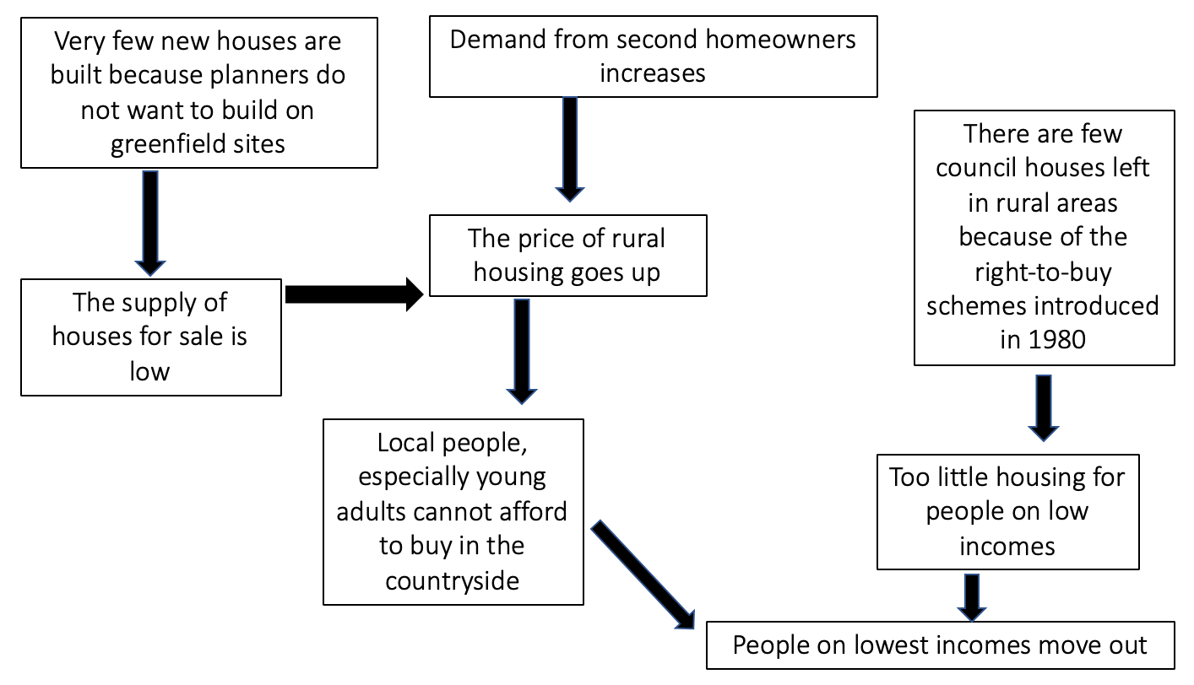
Population in the UK:
Types of Rural Environments:
Deep Green = Remote, isolated places with poor road networks. They have lots of open space and very sparse populations.
Rapid Change = Less densely populated areas and include some larger towns. Many people living here are commuters who work in urban environments.
Leisure and amenity = Some of the UK’s most beautiful scenery and National Parks are located here. They are in remote parts of the UK.
Coastal retirement = The population of these seaside towns include significant proportion of people who moved here when they retired.
Urban Spheres of Influence:
A complex web that links a city to its surrounding rural region. The city will often provide important social and economic benefits to the local area. This influence is stronger in places closest to the city and gets weaker with increasing distance.
Urban Regeneration:
Birmingham’s Big City Plan: aims to regenerate the city centre by improving transport links, creating new public spaces, and attracting businesses. It has brought investment, new jobs, and modern housing, especially around Eastside and the Jewellery Quarter. However, some argue regeneration causes gentrification, making areas less affordable for long‑term residents and increasing inequality.
Population Density is the amount of people that live in a certain space.
8 out of 10 people live in urban areas.
Population Distribution – How the people are spread out
This can be even or uneven.
Urban renewal is a program of land redevelopment often used to address urban decay in cities. Urban renewal is the clearing out of blighted areas in inner cities to clear out slums and create opportunities for higher class housing
Since 1964 the population of the UK has grown by over 10 million. The population is now around 65 million and is slowly increasing.
Post reproductive years (44-85+)
Rising demand for houses in the UK?
Reproductive years (15-44)
Cause -increased immigration, longer life expectancy and an increase in single-occupancy households all lead to an increase in the amount of home required. The government set a target to build a million new homes by 2020. In August 2016, the government admitted that it was going to miss that target by 266,000 homes.
Issue - In not building homes and missing targets it is likely to cause an increase in house prices due to supply and demand problems.
Pre-reproductive years (0-14)
Urbanisation:
‘A process where an increasing proportion of the population lives in towns and cities resulting in their growth.’
Natural Increase
Rural to Urban migration
Push Factors | Pull factors
War Poverty Drought Natural Disaster Lack of jobs | Employment Better access to services Friends and family.
Out of Town Shopping –
Traditional shopping centres have come under threat due to out of town shopping centres. Such as Merry Hill.
Urban Sustainability –
About ensuring that cities and towns have a minimal environmental footprint
Whilst there has been a large increase in urbanisation in developing countries (LIC’s and NEE’s), the opposite is occurring in most HIC’s. This is because of counter urbanisation
Counter urbanisation:
When large numbers of people move from urban areas into surrounding countryside or rural areas.
Advantages | Disadvantages
Large free parking areas Less congestion Quick and easy access Often room for expansion Near suburban housing | Causes a decline in city centre shopping Can increase congestion out of town Often has chain stores so does not support small independent shops
Egan’s wheel suggests that sustainable communities must meet ‘the diverse needs of existing and future residents, their children and other users’ by offering choice. Communities must:
Make effective use of natural resources
Enhance the environment
Promote social cohesion and inclusion
Strengthen economic prosperity.
Counter-urbanisation impacts the communities in many ways:
An increase in house prices due to higher demand
Fewer people in the village during the day
An increase in the number of people attending rural schools
Increased amounts of traffic and pollution in rural areas
Loss of villager ‘identity’ as the majority of residents do not work in the village.
The Issue of Second Homes:
Around 1.6 million people in England and Wales own a second home In the countryside that they use at weekends or holidays.
Mega-city:
Cities with more than 10 million residents are known as mega-cities. In 2015 there were 28 mega-cities. 16 in Asia, 3 in Europe.
Tokyo (Japan) is currently the largest 'megacity' in the world with 37.4 million inhabitants
Changes in Commuting patterns:
An increase in counter-urbanisation in HIC’s has meant that more people are commuting long distances to work.
How are rural areas changing?
Counter-urbanisation, sphere of influence and technological change has led to changes in rural areas.
Reduction or change in employment opportunities in rural areas
Closure of rural services
Increased ‘second home ownership’.
Reduction in bus services as less people use them.
Some of the ‘deep green’ rural areas have experienced negative change. Such as depopulation and deprivation (characterised by lack of public transport, healthcare and education).
Factors leading to increased commuting | Pull factors
Cities have more jobs than rural areas Rural housing is often cheaper Better road and rail have cut journeys in half Improvement in car safety has encouraged people to drive longer distances. | People can work away from central office due to better internet and mobile coverage Skype has meant people do not have to travel to meetings
RURAL-URBAN LINKS
Rural sustainability -
Reliability and frequency of transport – ensure the public have access to transport
Economic investment in tourism – Attract visitors to the area to create jobs and bring money.
Availability of jobs – secure investment from companies
Internet connections – reliable
Education – ensure village schools remain open and there is a wide range of subjects taught
Healthcare – Ensure doctors and hospitals can be accessible
Village services – Encourage local post offices, pubs to remain open for people to use.
Green technologies – Promote the use of renewable energy
Case study – Cardiff:
Half the population of Wales, 1.49 million people live within 32km of Cardiff city centre. Almost 78,000 people commute into Cardiff and about 39,000 commute out of Cardiff each day. Cardiff commuters are often stuck in ques on the A470 from the north and A48 to the east. This causes traffic and can cause delays of up to an hour.
Solutions to the congestion problem - Cardiff has three park and ride schemes, cycle routes, bus lanes, flexi hours so that businesses start and finish at different times as well as water taxi to take passengers from Cardiff Bay to the city centre.
Clone Town = Town where the High Street or other major shopping areas are significantly dominated by chain stores.

Slide 2
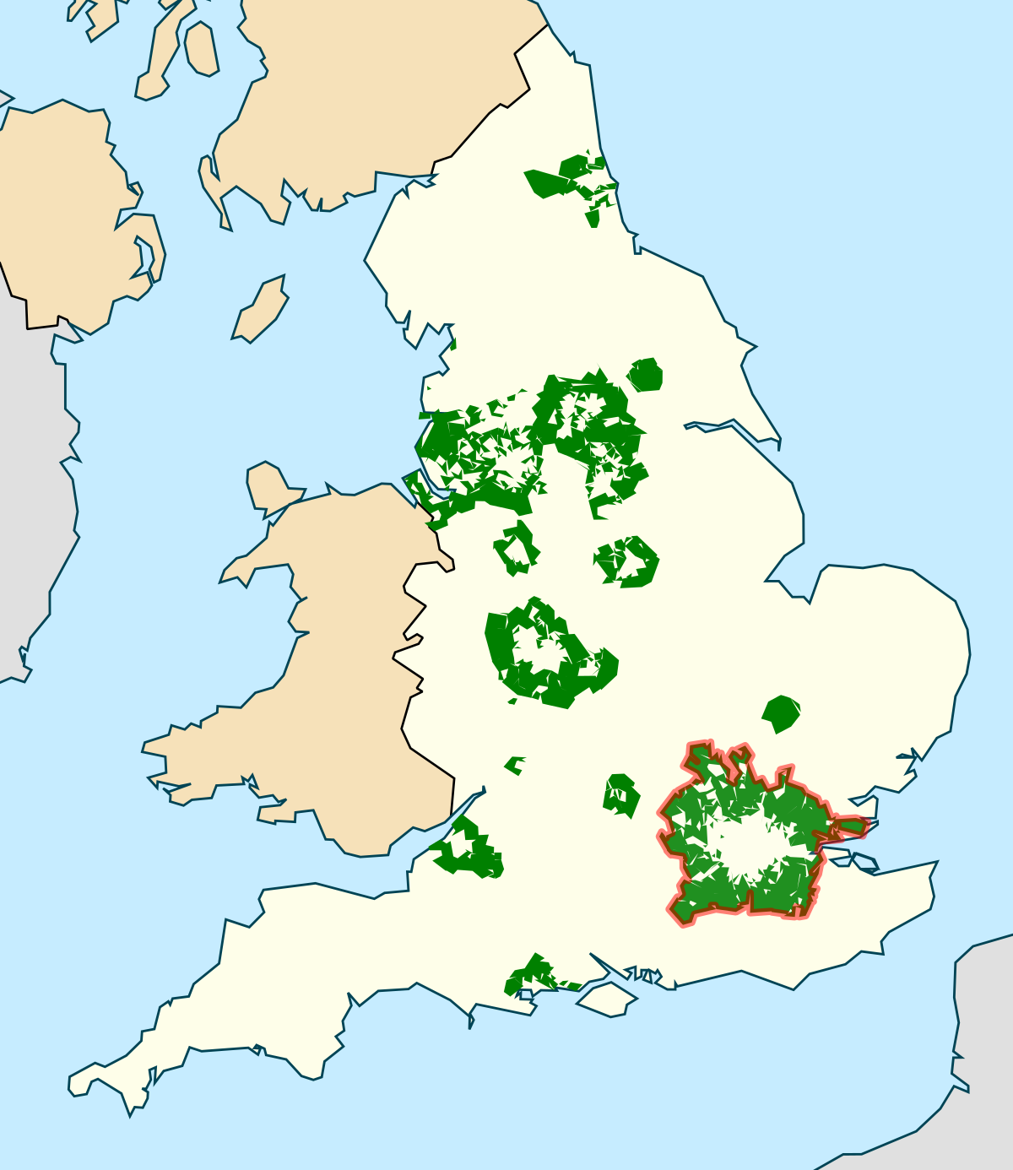







Greenfield Site vs Brownfield Site
UK Ageing Population –
By 2025, more than a third of the UK's population will be over 55.
There are two reasons for this; an increase in life expectancy and a decline in the fertility rate.
Case study – Birmingham :
Facts:
Birmingham, located in England’s West Midlands, is the UK’s second-largest city with over 1.1 million people. It grew rapidly during the Industrial Revolution as a manufacturing hub but faced decline during deindustrialisation. Today, it is a diverse, youthful city with over 100 languages spoken. Regeneration projects like Eastside and The Bull Ring , plus HS2, aim to boost connectivity and economic growth. Opportunities include cultural attractions, universities, and green spaces.
However, challenges remain: deprivation, housing shortages, and environmental pressures.
Over 51% of residents are from ethnic minority backgrounds, including large South Asian, African-Caribbean, and Eastern European communities. More than 100 languages are spoken, and the city has vibrant cultural areas like the Balti Triangle for South Asian cuisine and Digbeth for creative industries. This diversity influences Birmingham’s festivals, food, music, and places of worship, making it one of the UK’s most multicultural cities. Migration for work, education, and refuge has shaped its identity, creating a youthful, globally connected urban population.
In British town planning, the green belt is a policy for controlling urban growth. The idea is for a ring of countryside where urbanisation will be resisted for the foreseeable future, maintaining an area where agriculture, forestry and outdoor leisure can be expected to prevail.
Impacts:
There are a growing number of wealthy older people
The proportion of people of working age is shrinking while the proportion of people who are retired is growing
The number of older people who live alone is increasing
The number of older people who have complex or long term health issues is growing
Responses:
Encourage people to take up regular exercise
Encourage migration of younger people
Encourage young people to start saving to pension scheme sooner
Discourage smoking, alcohol and overeating
Raise the age people can access their old age pension.
Greenfield sites | Brownfield sites
Encourages urban sprawl, so are not favoured by environmentalists Reduces area of countryside Cheaper to build on Encourage commuting and therefore traffic (causing pollution) | Valuable, since old building can be split up into new homes Use unsightly areas and redevelop them, therefore improves the urban environment Reduces urban sprawl because the site has previously been developed Found in urban areas, so reduces demand on car use
Burgees Model –
This leads to high-rise, high-density buildings being found near the Central Business District (CBD), with low-density, sparse developments on the edge of the town or city.
The model is now quite old and was developed before the advent of mass car ownership.
New working and housing trends have emerged since the model was developed. Many people now choose to live and work outside the city on the urban fringe - a phenomenon that is not reflected in the Burgess model.
Every city is different - there is no such thing as a typical city.
Global city
How well connected they are to the rest of the world and the global economy.
Transport hubs – good access by rail and air
- developed road
Information – state of the art communication
Demographics – large population
- Ethnic diverse with high tolerance
- high proportion of educated population
Culture – centre of excellence of arts
- rich heritage
Finance and trade – major hubs of international banking
- headquarters of multinational companies
Governance – national seat of government
TEST YOURSELF:
Explain why a large urban area would have a sphere of influence over a neighbourhood rural area (4 marks)
What do you understand by the term. ‘remote rural area’ (2 marks)
For an example you have studied, describe the pattern of commuting (4 marks)
What do you understand by the phrase ‘rural poverty and deprivation’ (2 marks)
Discuss the challenges that are faced in creating sustainable. Rural communities. (8 marks)
Describe any two Egan’s wheel part (4 marks)
Evaluating the various options available to alleviate the current housing crisis in the UK (8 marks)
Describe why cities in NIC are growing at the fastest rate (4 marks)
Describe the characteristics that cities need to become classified as a global city (4 marks)
For two global cities that you have studied, describe the connections that they have to the rest of the world and decide which connection is most important to the city (8 marks)
Case study – Mumbai:
Facts:
Mumbai is India’s largest city with a population of 18.4 million in 2015
Growth is due to natural increase and rural-urban migration
How is Mumbai a global city?
Political – Location of India's government buildings.
Communication – Mumbai airport carried over 36million passengers to 45 different countries in 2015.
Demographics – migrants constitute about 37 per cent of Mumbai population.
Finance and Trade – location of India’s stock exchange as well as hosting the headquarters of MNC’s such as Cadbury India, Volkswagen, and Tata steel
Free education with more than 1000 schools
More people have electrical supply .
Push:
Poor standard of housing
New farming techniques meant there were less farming jobs
Poor sanitation
Pull:
Cheap rail – costs about £2.50 to travel from one side of India to the other
More variety of jobs – transnational corporations
Better wages
Better education opportunities
More access to healthcare
Case study – London:
London is a global city as it is home to some of the world's top universities. There are around 300 languages spoken. 37% of the population was born outside the UK. There are endless opportunities for entertainment such as the West End. It has 3 international airports. Houses of Parliament and Canary Warf.
Online Shopping –
In 2014 almost ¾ of adults reported buying goods online which is more than double that of 2003.
About 50% of online shopping in 2015 was made on a mobile device.
Command Words:
Analyse - Take apart an idea, concept or statement and
criticise it.
Assess - Come to a conclusion about the overall value or significance of something; discuss its positive and negative aspects to show balance.
Compare - Identify similarities and differences.
Define - State the meaning of an idea or concept.
Describe - Set out the main characteristics of something; DON’T EXPLAIN.
Discuss -Set out both sides of an argument (for and against) and come to a conclusion; there should be some evidence of balance.
Evaluate - Make a judgement about the effectiveness of something; discuss its strengths and weaknesses and come to a conclusion about its overall success or importance.
Explain - Give reasons why something happens.
Give - Produce an answer from recall.
Justify - Support an idea or argument with evidence; for the outcome chosen, the positives must outweigh the negatives.
State = name
To what extent - Discuss and conclude how far you agree or disagree with a statement or view.
Countries categorisation –
HIC = High Income Country- A country that has a GNI per capita of $12,746 or above according to the World Bank.
LIC = Low Income Country - Countries that have a GNI per capita of $1,045 according to the World Bank
NIC = Newly Industrialised Country - Have a large percentage of countries working in the secondary sector
Advantages | Disadvantages
Convenience - shop from any computer or mobile phone with an internet connection any time, while avoiding the need to travel, pay for parking and queueing. Greater variety - more shops online than any high street or retail park. Cheaper goods - increased competition between retailers Accessibility - those with a disability that limits their mobility Comparability - using the internet makes it easy to research products or services | Security concerns surrounding payment by credit card over the internet. Not being able to physically inspect the goods before purchase. Goods getting damaged during transport. Goods not arriving in time or at all. Concerns over what information retailers are storing about customers, eg buying habits. Fewer people visiting the CBD, high street and retail parks.
Literacy rates are high (89.7%). Even in the slums, the literacy rate is estimated to be more than 69%.
Water pipes run close to the sewers causing leaks
Crime rates are high – 1/3 of population have been victims of crime
62%. Of the population lives in sums today
Solutions – upgrade street toilets, give residents new homes, upgrade street drains.
Housing in Mumbai – Pavement Dwellers/ Slum/ Chawls
Bhendi Bazaar is a mixed area of chawls and 1,250 shops and stalls. It is estimated that 20,000 people live here. The chawls are old and overcrowded. There is no proper waste disposal system and water is only supplied for a few hours each day. An ambitious plan will demolish 250 buildings and replace them with 17 high rise tower blocks.
Box = command word
Underline = key words
Glance = back

